Slide 1
Interactive digital Portfolio

Slide 2
Name : Kuldeep Kirit Prajapati Registered No: STU687e5838d7ca81753110584 NMID: STU687e5838d7ca81753110584 Department : Computer Science and Engineering College : Drs. Kiran and Pallavi Patel Global University Vadodara (KPGU)

Slide 3
OUTLINE
Problem Statement
System Development Approach (Technology Used)
Algorithm & Deployment (Step by Step Procedure)
Result
Conclusion
Future Scope (Optional)
References

Slide 4
Problem Statement
Students and professionals often struggle to showcase their skills, projects, and achievements in an engaging way.
Traditional resumes and static portfolios are not interactive, visually appealing, or easily accessible.
There is a need for a dynamic and user-friendly online portfolio that effectively highlights individual skills and projects, while being easy to update and share.

Slide 5
Problem Statement
Lack of Engaging Presentation: Traditional resumes and static PDF portfolios are passive documents that fail to dynamically demonstrate technical skills or create a memorable impression on recruiters.
Ineffective Project Showcasing: It's challenging to present coding projects, designs, and achievements with the necessary context, visuals, and interactivity on a standard CV.
Accessibility & Shareability Issues: Physical resumes are limiting, and many portfolio solutions are not easily shareable with a single link or quickly accessible to global recruiters.
Static Nature: Updating a traditional portfolio with new skills or projects often requires cumbersome software or re-printing, making it inefficient to maintain.

Slide 6
Problem Statement
Inefficient Discovery for Recruiters: Recruiters lack a central, engaging hub to quickly evaluate a candidate's full range of work—including live project links, GitHub repositories, and case studies—without navigating multiple disjointed sources.
High Barrier to Maintenance: Many professionals avoid portfolio maintenance due to the perceived complexity of web development or the cost of platforms, causing their online presence to become outdated.

Slide 7
System Approach
Frontend Technologies:
HTML5 – Structure of the portfolio website
CSS3 – Styling and responsive layouts
JavaScript – Interactive elements (navigation, filtering, animations)
Design Approach:
Modern and minimal UI/UX design
Mobile-first responsive design
Clear separation of HTML, CSS, and JS files for modularity

Slide 8
System Approach
1. Core Technology Stack:
HTML5: Provides the semantic skeleton of the website, ensuring a logical structure, accessibility, and SEO-friendly foundation. Utilizes modern elements like <header>, <section>, <article>, and <nav> for clear content definition.
CSS3: Drives the complete visual presentation and user experience. Implements:
Flexbox & CSS Grid: For creating complex, responsive, and fluid layouts that adapt seamlessly to all screen sizes.
Custom Properties (CSS Variables): For maintaining a consistent theme (colors, fonts, spacings) and enabling easy future modifications.
Animations & Transitions: For enhancing user engagement with smooth scroll behaviors, hover effects, and section transitions.

Slide 9
System Approach
Key Features:
Semantic HTML for accessibility and SEO.
CSS Custom Properties for consistent theming.
Dynamic content rendering and DOM manipulation with JavaScript.
Smooth animations and transitions for enhanced UX.

Slide 10
Algorithm & Deployment
Portfolio Content Creation – Collect personal details, skills, projects, and achievements.
Frontend Design – Layout with HTML and CSS (sections for About, Skills, Projects, Contact).
Interactive Features – Smooth navigation, project filtering, modal views, contact form integration.
Testing – Browser compatibility, responsiveness on different devices.
Deployment – Host using GitHub Pages / Netlify for free and easy access.

Slide 11
Algorithm & Deployment
Content Strategy: Curated and structured all portfolio content, including bio, skill set, project case studies, and contact information.
UI/UX Design & Development: Built a fully responsive and visually appealing frontend with HTML and CSS, featuring a clean, intuitive layout.
JavaScript Interactivity: Developed core interactive features: smooth navigation, dynamic project filtering, modal pop-ups for project details, and a validated contact form.
Cross-Platform Testing: Ensured flawless performance and visual consistency across all major browsers and mobile devices.
Deployment & Hosting: Published the live site using Netlify/GitHub Pages for reliable, free hosting and streamlined update workflows.

Slide 12
Algorithm & Deployment
Portfolio Content Creation:
Action: Collected and organized personal details, skills, projects, and achievements.
Goal: To create a compelling narrative and ensure all information is targeted towards potential employers or clients.
Frontend Design & Architecture:
Action: Designed and implemented the layout with HTML and CSS, creating distinct sections (About, Skills, Projects, Contact).
Goal: To ensure a logical user journey, clear information hierarchy, and a professional aesthetic that aligns with modern web standards.

Slide 13
Algorithm & Deployment
Interactive User Experience:
Action: Added smooth navigation, project filtering, modal views, and form integration using JavaScript.
Goal: To increase user engagement, allow visitors to easily explore my work, and provide a direct channel for communication.

Slide 14
Algorithm & Deployment
Comprehensive Testing Protocol:
Action: Performed browser compatibility and responsiveness checks on various devices.
Goal: To guarantee a consistent and positive experience for every user, regardless of how they access the site.
Deployment & Live Launch:
Action: Hosted the portfolio on GitHub Pages/Netlify.
Goal: To make the portfolio easily accessible to anyone with a link, utilizing a robust and free platform for quick deployment and future updates.

Slide 15
Result
A fully functional Interactive Portfolio Website.
Screenshots of homepage, skills section, projects, and contact form.
GitHub Link: https://github.com/kuldeepin3

Slide 16
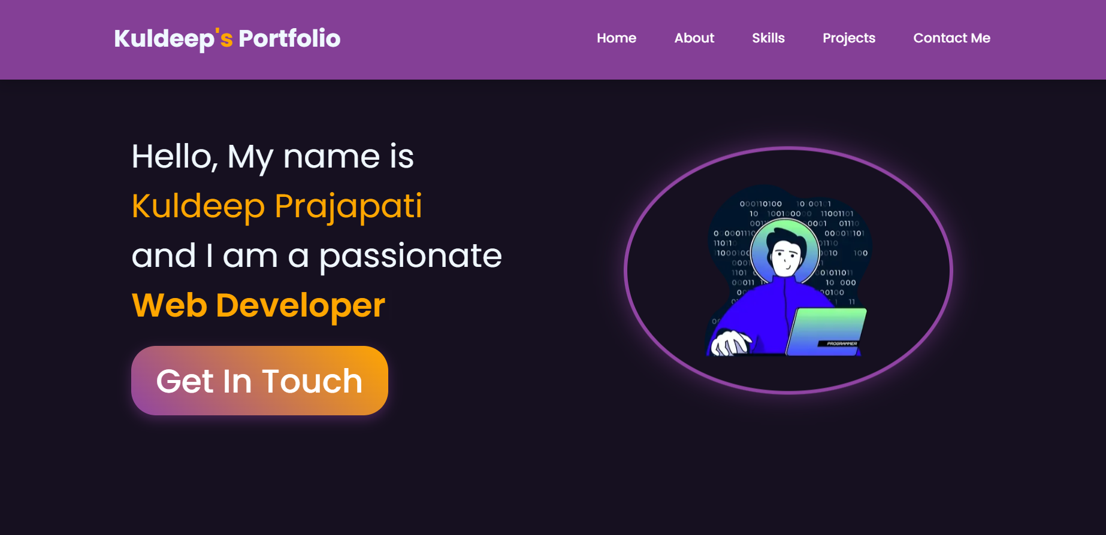
Homepage

Slide 17
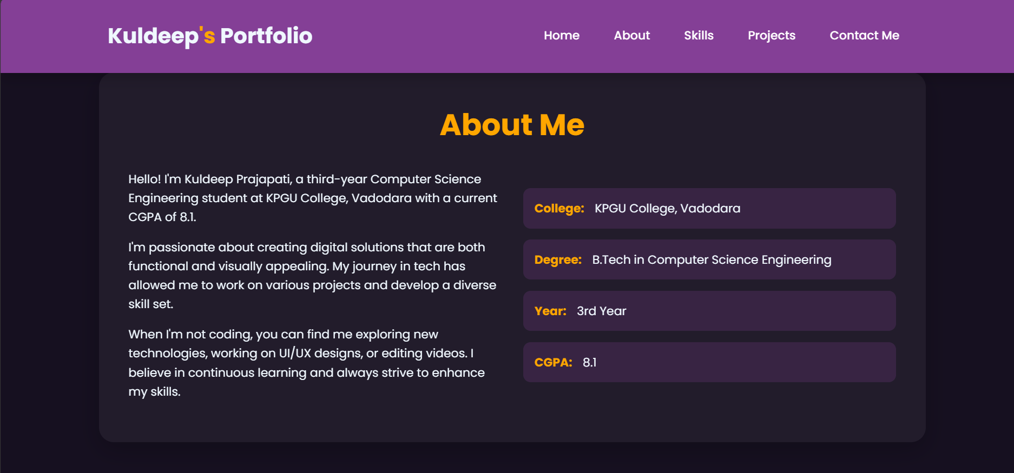
About me

Slide 18
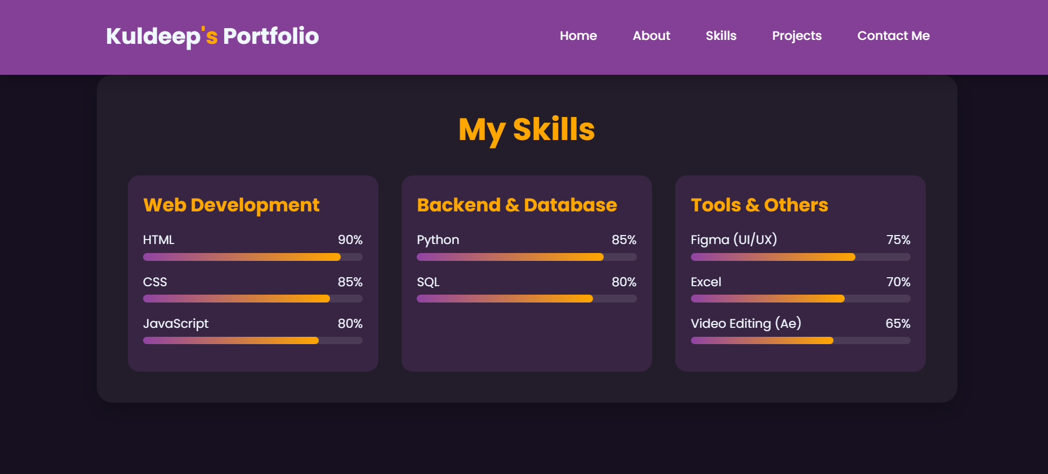
skills

Slide 19
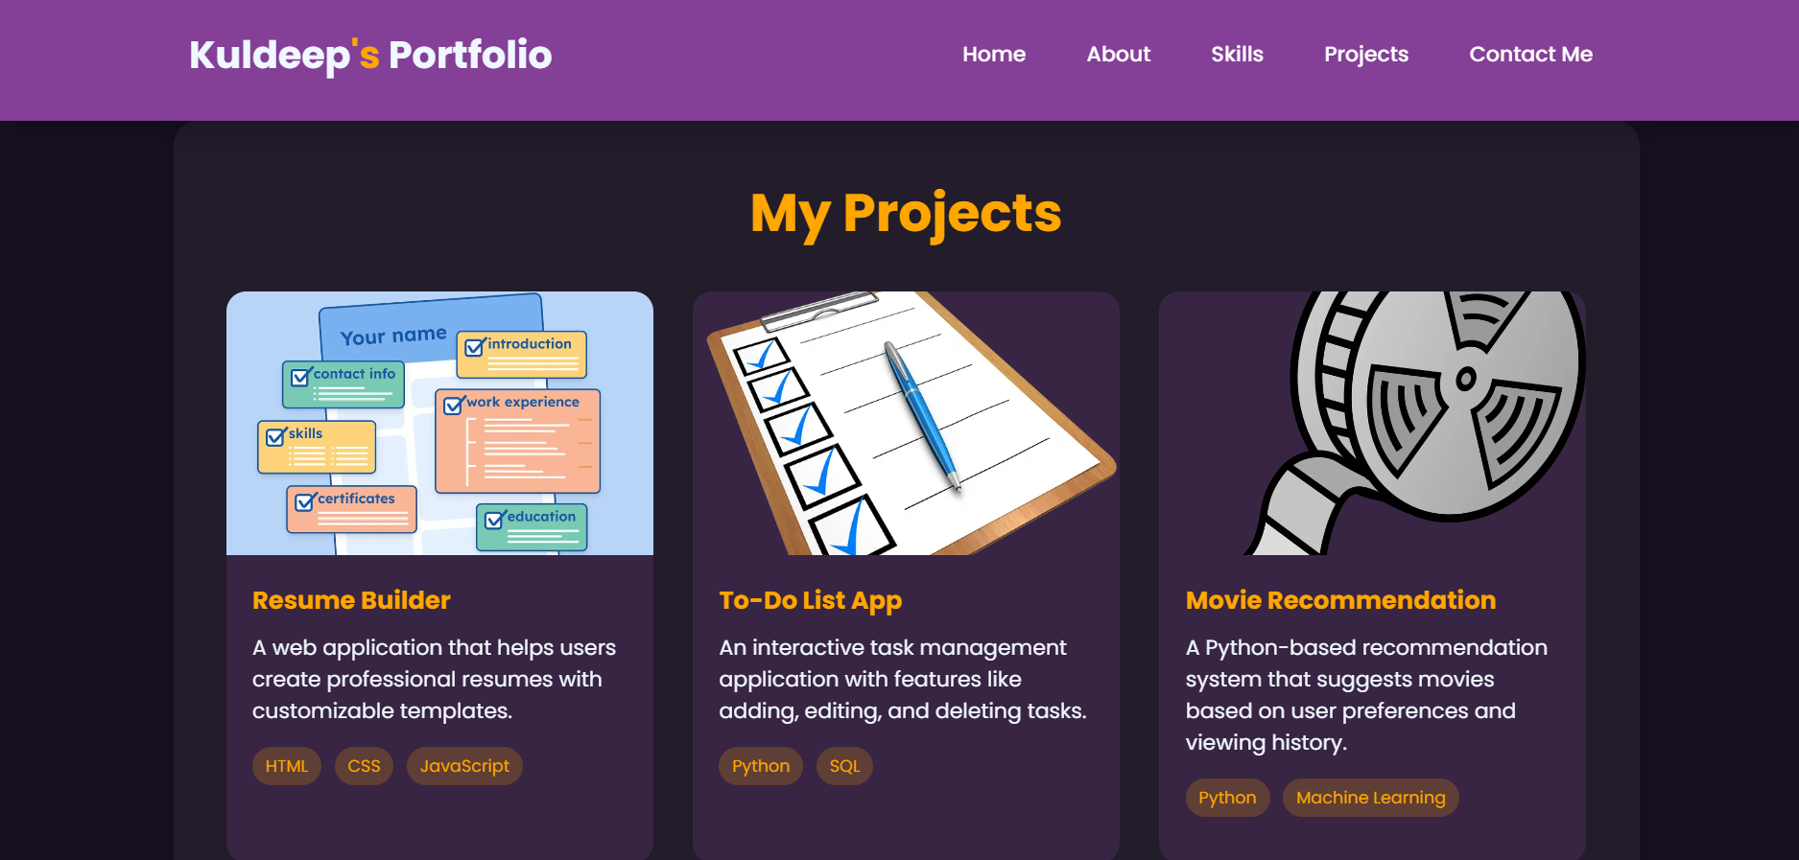
projects

Slide 20
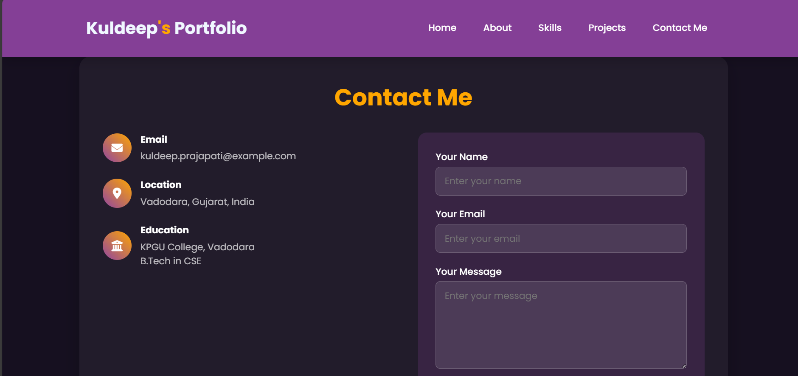
Contact me

Slide 21
Conclusion
Establishes a Dynamic Professional Hub: Moves beyond a static resume to create a central, engaging platform that actively represents my personal brand and capabilities to the world.
Demonstrates Technical Proficiency Practically: The portfolio itself acts as a live example of my front-end development skills (HTML, CSS, JavaScript), proving my ability to build modern, responsive web applications.
Curates a Compelling Narrative of Work: Provides an immersive environment to showcase not just project lists, but detailed case studies with visuals, explanations, and links, effectively telling the story of my skills and achievements.

Slide 22
Conclusion
Streamlines the Recruitment Process: Offers recruiters and hiring managers an easily accessible, comprehensive overview of my qualifications, saving them time and providing a more memorable candidate experience than a traditional paper CV.
Facilitates Global Connectivity and Networking: Serves as a always-available, easily shareable link that connects me with opportunities worldwide, allowing peers and potential employers to discover and evaluate my work on demand

Slide 23
Conclusion
"The development of this interactive portfolio successfully establishes a powerful professional online presence. It transcends the limitations of a traditional resume by providing an engaging, hands-on demonstration of my technical skills and design aesthetic. The portfolio effectively showcases my projects and achievements in a dynamic format, creating a memorable experience for recruiters. Furthermore, its ease of sharing as a single link facilitates seamless connection with opportunities across the globe, making it an indispensable tool for my career growth."

Slide 24
Conclusion
Provides a professional online presence.
Makes resumes more interactive and engaging.
Showcases projects, skills, and achievements effectively.
Easily shareable with recruiters and peers.

Slide 25
References
Bootstrap v5.3 Documentation
W3Schools HTML/CSS/JavaScript Resources
GitHub – Hosting Guides
FreeCodeCamp – Responsive Web Design Curriculum

Slide 26
THANK YOU

